Slide 1

Introduction to OPC UA
https://opcfoundation.org
https://www.matrikonopc.com

Slide 2
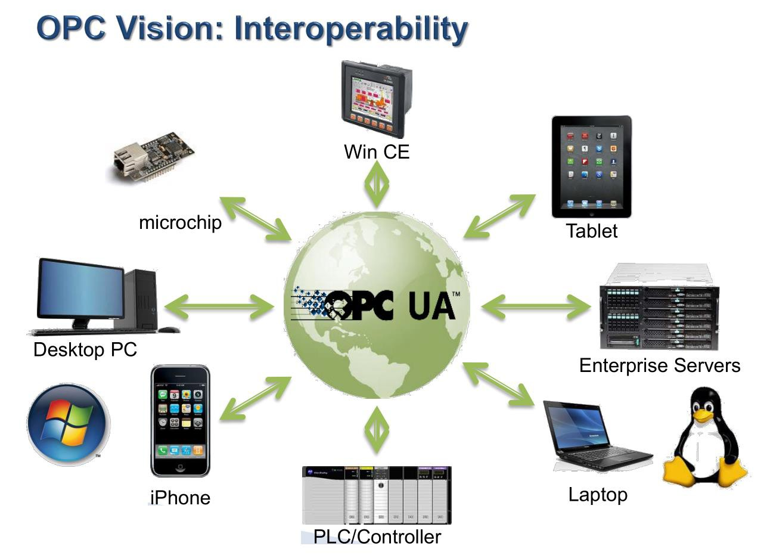
Introduction to OPC UA
Introduction to OPC UA
OPC UA stands for Open Platform Communications Unified Architecture
Data exchange standard for industrial communication
Open interface standard is independent of:
Manufacturer
System application
Programming language
Operating system

Slide 3
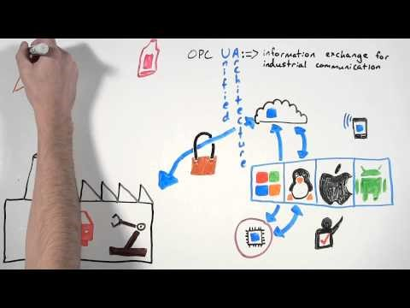
https://youtu.be/-tDGzwsBokY

Slide 4
What is OPC
OLE for Process Controls (Previously known)
Open Platform Communications (Current)
The Interoperability standard for secure and reliable exchange of data in industrial automation
Extract data from PLC via protocols such MODBUS, PROFIBUS to a standardized interface for PC based SCADA to seamlessly communicate (Plug & Play)
OLE – Object Linking and Embedding
OPC Foundation is responsible for development and maintenance of this standard

Slide 5
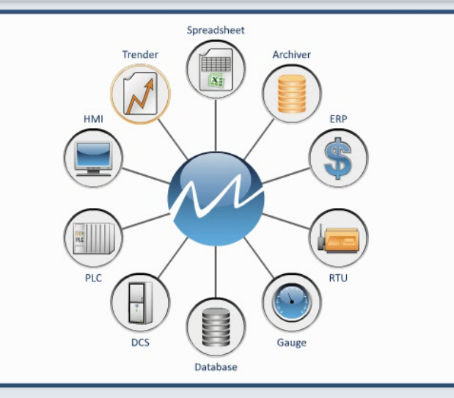
OPC standard is a series of specifications developed by industry vendors, end users and software developers to:
Interface clients and servers
Interface servers to servers
Access to real-time data
Monitoring of alarms and events
Access to historical data
Credits: Matrikon

Slide 6
OPC Classic
OPC Data Access (DA) defines the exchange of data values, timestamp and quality
Read / Write data
Subscribe / Unsubscribe data
Real-Time Data
OPC Alarms & Events (OPC AE) defines the exchange of alarm and event type message information, as well as variable states and state management
OPC Historical Data Access (OPC HDA) defines query methods and analytics that may be applied to historical, time-stamped data
Based on Microsoft Windows technology using the COM/DCOM (Distributed Component Object Model) for the exchange of data between software components

Slide 7
OPC Classic to OPC UA
2008, OPC Foundation released OPC Unified Architecture (OPC UA)
From Windows based to platform independent (including non-Microsoft systems) Service-Oriented Architecture (SOA)
Motivating factors for the move from classic to UA:
Microsoft has de-emphasized COM and DCOM in favor of cross-platform SOA
OPC vendors need to implement OPC on non-Microsoft systems, including embedded devices for better competitiveness
OPC vendors want a single set of services instead of having separate Data Access, Alarms & Events, Historical Data Access
Windows Based
Windows, Linux, Mac, Embedded, etc
OPC DA Server
OPC Client (DCOM)
OPC UA Server
OPC UA Client
OPC A&E Server
OPC HDA Server

Slide 8
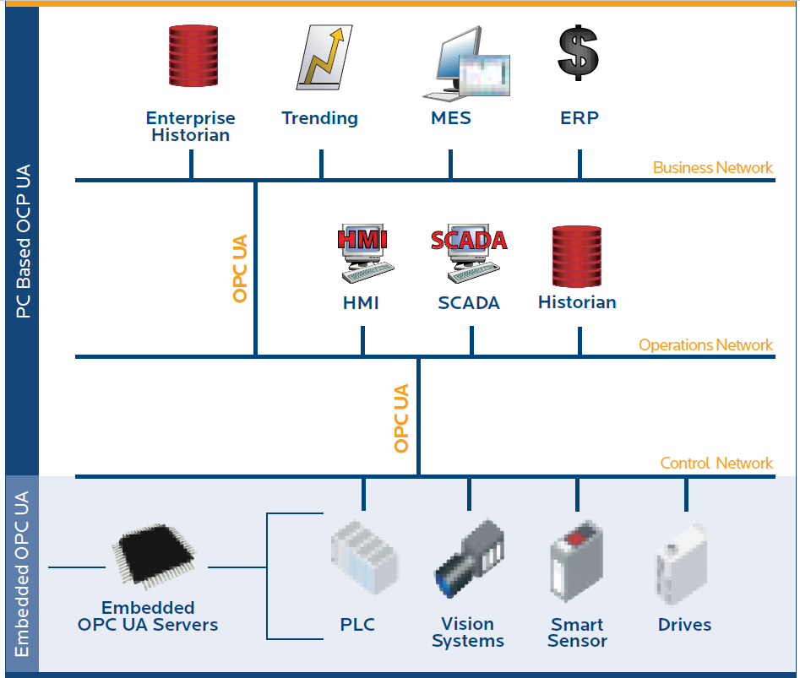
OPC UA
Unified Access OPC UA integrates existing OPC specifications into one common specification
Access via Firewalls and across the Internet OPC UA uses message based security, relaying messages through HTTP, UA TCP port or available port
Security OPC UA is Secure-by-default, encryption enabled, and uses advanced certificate handling.
Platform Independence OPC UA is designed to be independent of the platform. SOAP/XML over HTTP, OPC UA can be deployed on Linux, Windows XP Embedded, VxWorks, Mac, Windows 7, and Classical Windows platforms
https://www.matrikonopc.com/opc-ua/index.aspx

Slide 9
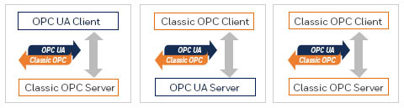
OPC UA Functions
On top of functional equivalence of OPC classic, OPC UA is able to do more:
Discovery: find availability of OPC Servers on local PCs and/or networks
AddressSpace: Data represented hierarchically via files and folders for complex structures to be discovered and utilized by OPC Clients
On-demand: Read and write data/information based on access-permissions
Subscriptions: Monitor data/information and report-by-exception when values change based on a client’s criteria
Events: Notify important information based on client’s criteria
Methods: Clients can execute programs, etc. based on methods defined on the server
Integration between OPC UA products and OPC Classic products is easily accomplished with COM/Proxy wrappers (Tunnelling)

Slide 10
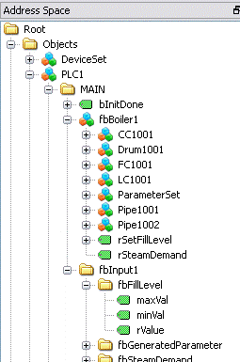
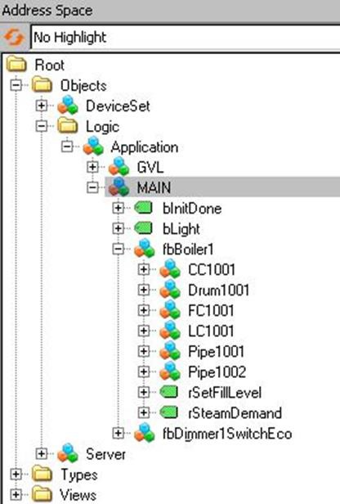
OPC UA in PLC: The Server
Beckhoff
“PLC1”
Bosch-Rexroth
“Logic”
OPC UA Interoperability
Different entry point
Standardized by PLCOpen and OPC Foundation
Different PLC brands, same object structure
Write object code in PLC, make assessable it in OPC UA server
... but semantically identical objects!

Slide 11
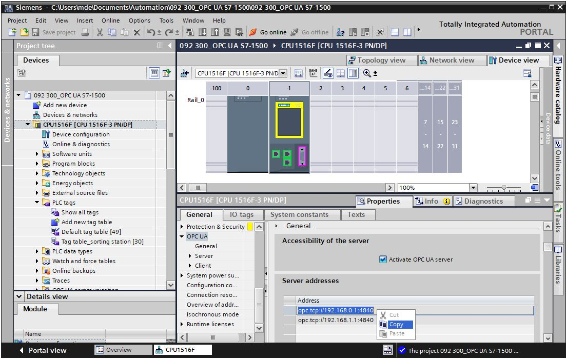
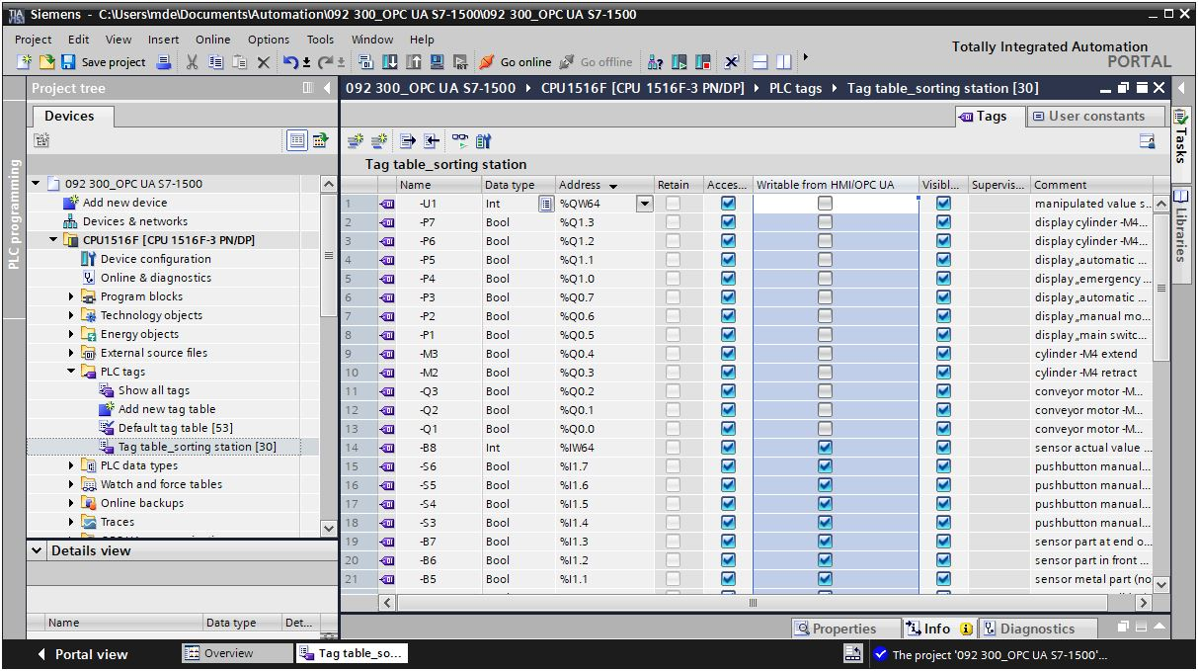
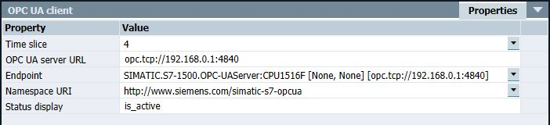
OPC UA Interoperability
Accessible Setting
Activate OPC UA Server
Configure OPC UA Client

Slide 12
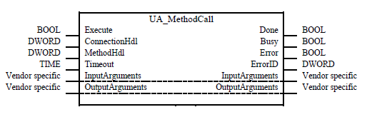

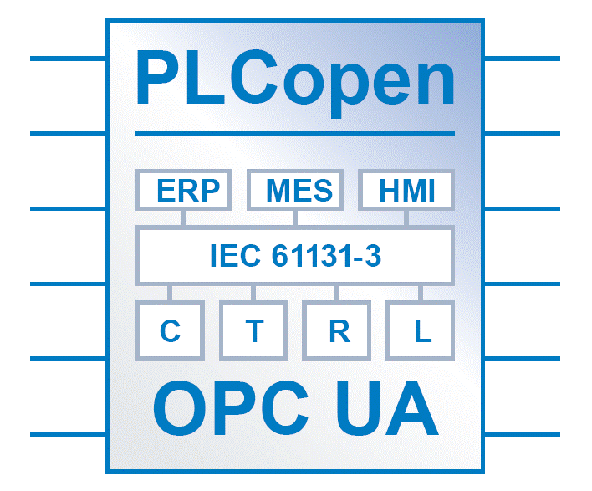









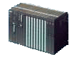
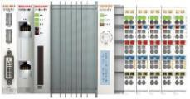
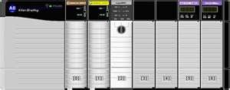




OPC UA Integration
Connection > from the controller < Controller initiating communication
Interoperability between PLC brands
Horizontal communication between devices
Vertical communication to ERP / MES
Plant Engineering
MES System
Data bas e
Virtual machine
OPC UA Server
OPC UA Server
Vertical & Horizontal
Fieldbus independent
It’s fast – but not a fieldbus

Slide 13

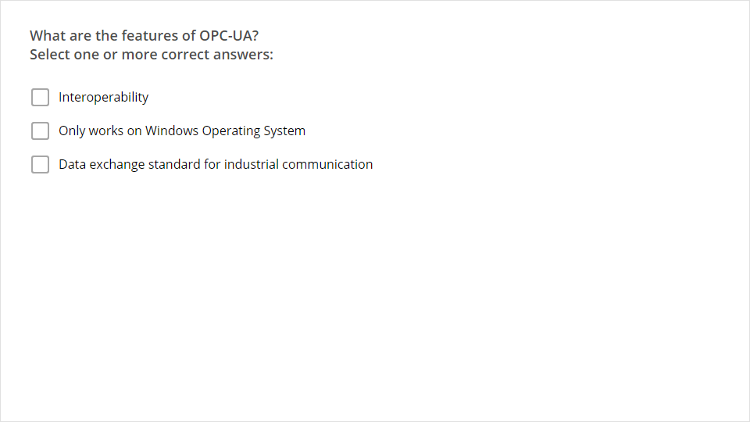
Quiz
Click the Quiz button to edit this object

